Slide 1

Classification problems and logistic regression

Slide 2
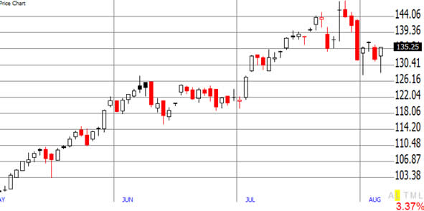
Regression vs classification
Regression: response variable is quantitative
Temperature forecast for tomorrow
Company growth prediction for the next quarter

Slide 3
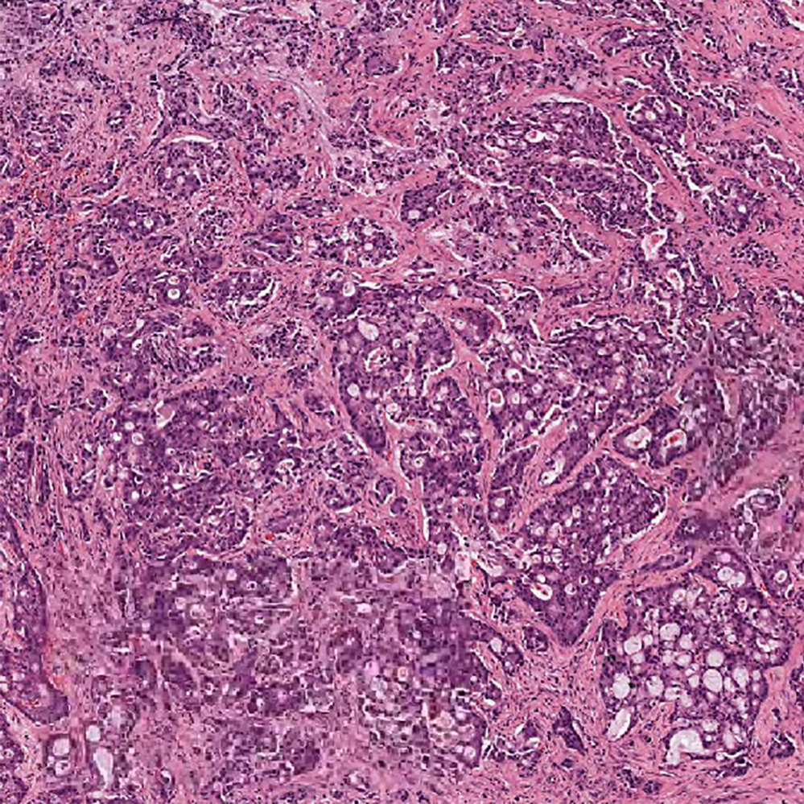
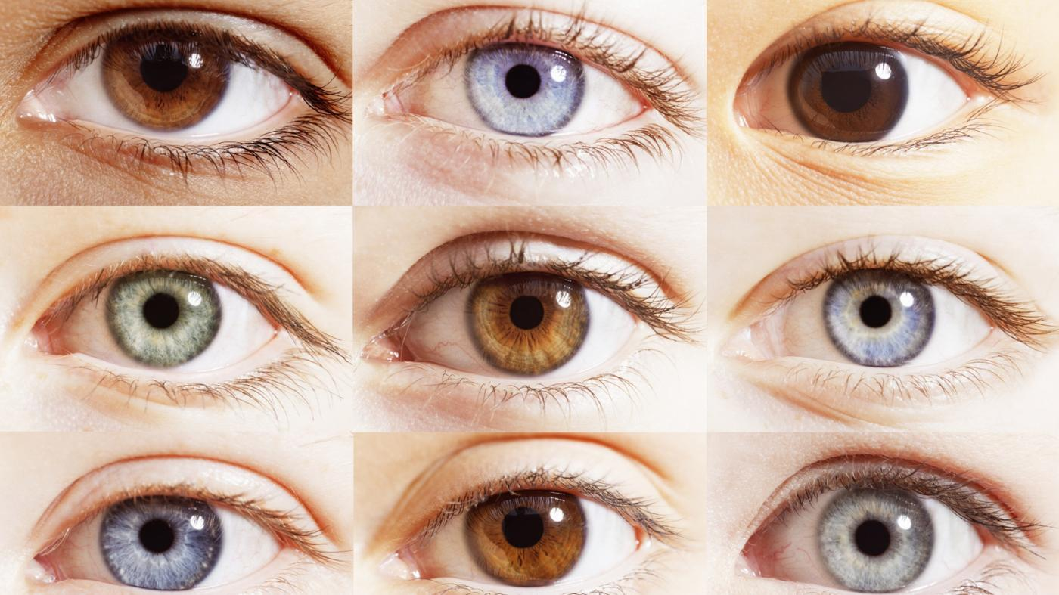
Regression vs classification
Classification: response variable is qualitative
Detection of cancer in human tissue (cancer / no cancer)
Prediction of eye colour using DNA sequencing

Slide 4
Regression vs classification
Regression: response variable is quantitative
Temperature forecast for tomorrow
Company growth prediction for the next quarter
Classification: response variable is qualitative
Detection of cancer in human tissue (cancer / no cancer)
Prediction of eye colour using DNA sequencing

Slide 5
Problem statement
Efficient recycling requires separation of plastics / glass by their type, use data science to do this automatically.
Data set: “Glass Identification Data Set from UCI. It contains 10 attributes including id. The response is glass type.”
The goal is to predict if a glass sample is recyclable or not!

Slide 6
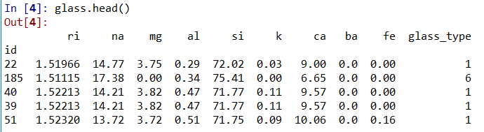
Data set
9 features:
ri – refractive index na – sodium mg – magnesium
al – aluminum si – silicon k – potassium
ca – calcium ba – barium fe - iron

Slide 7
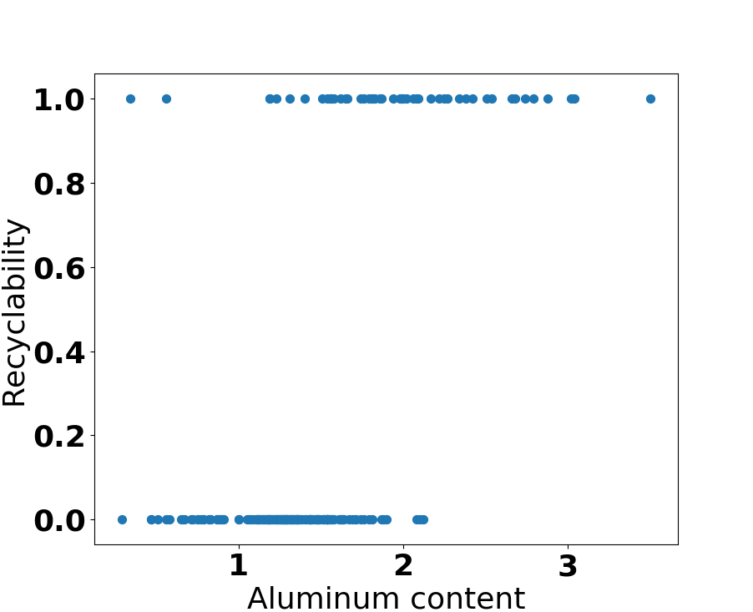
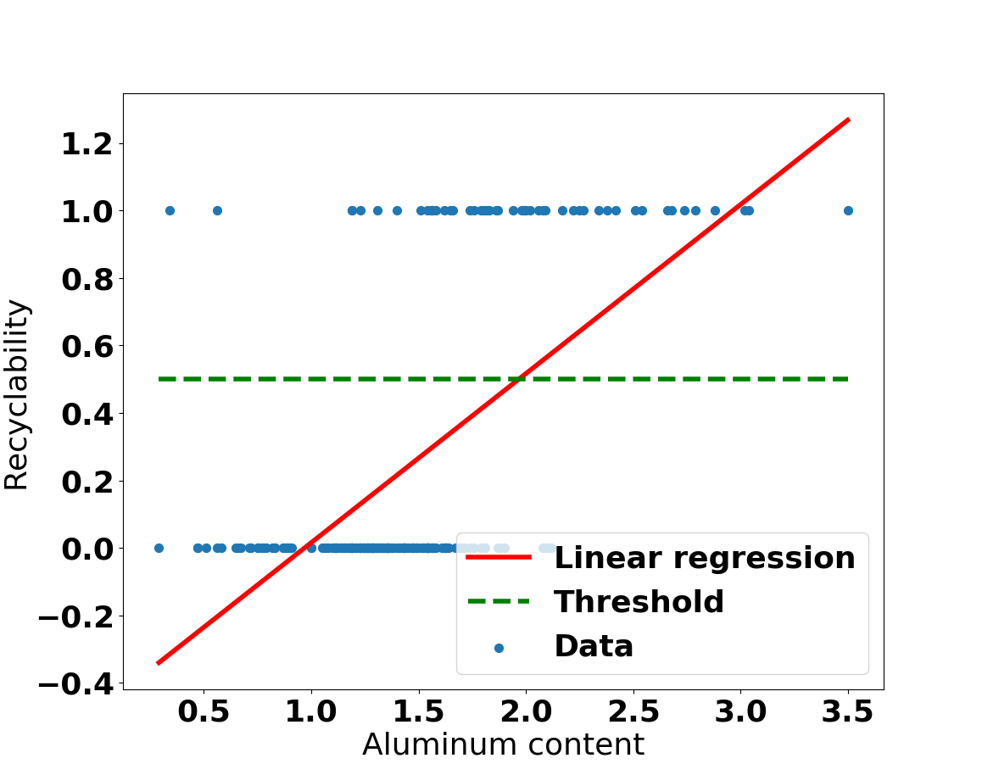
In principle, can use regression:

Slide 8
Predicted values can be mapped:
> 0.5 → 1
< 0.5 → 0
Key questions:
What is the significance of the predicted values?
What happens with more than two labels?

Slide 9
Why not linear regression?
Cannot predict probability of the sample’s label, linear function is not bounded between [0,1].
In case of more than two labels, labeling sets inherent order.

Slide 10
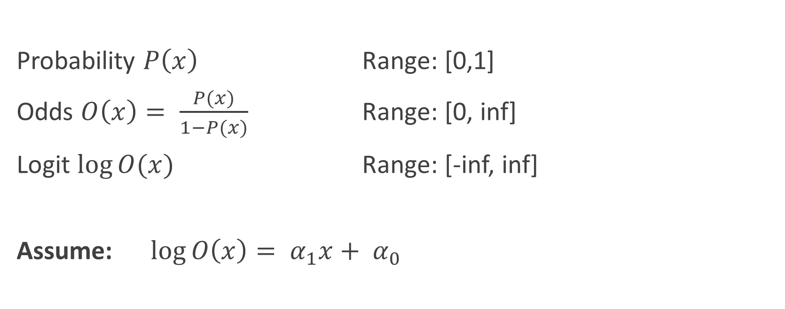
Logistic Regression
Probability $P\left(x\right)$ Range: [0,1]
Odds $O\left(x\right)= \frac{P(x)}{1−P(x)}$ Range: [0, inf]
Logit $\log{O(x)}$ Range: [-inf, inf]
Assume: $\log{O\left(x\right)= α_{1}x+ α_{0}}$

Slide 11
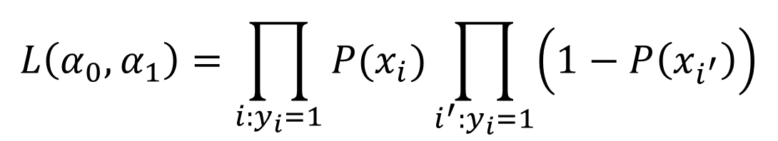
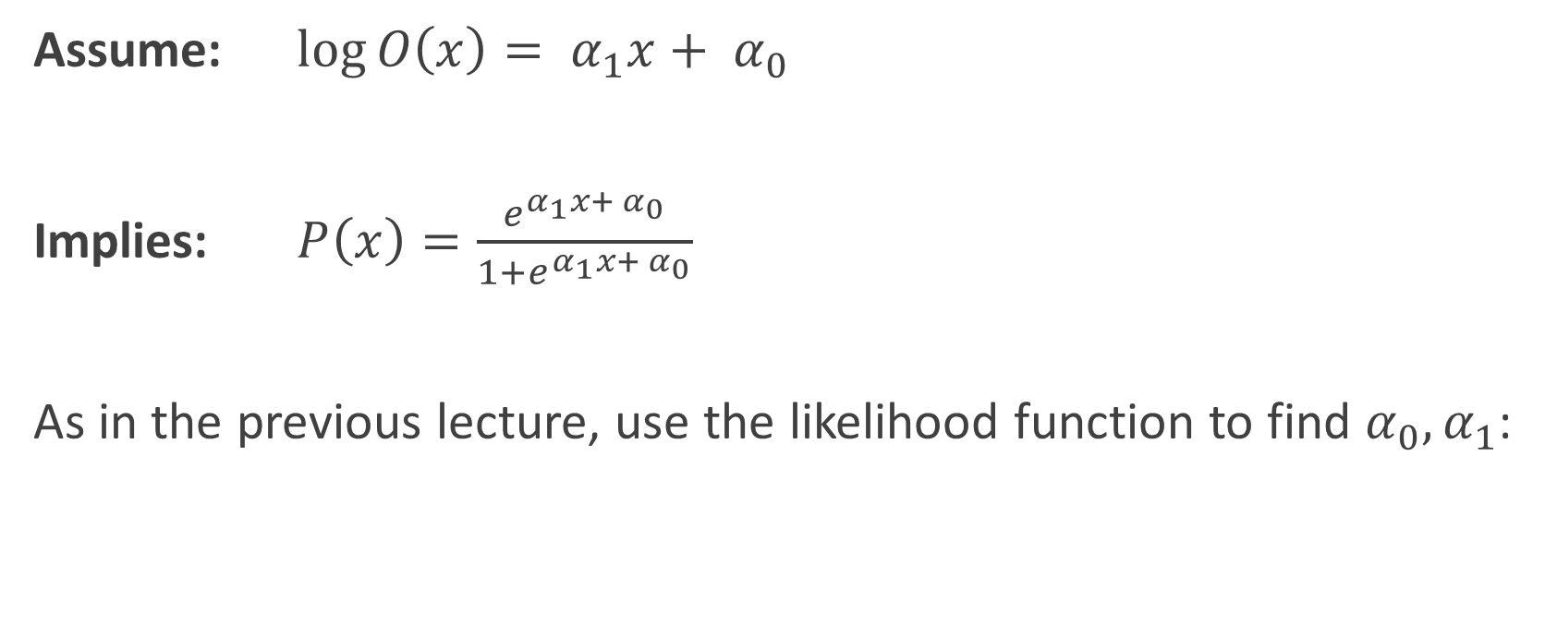
Assume: $\log{O\left(x\right)= α_{1}x+ α_{0}}$
Implies: $P\left(x\right)=\frac{e^{α_{1}x+ α_{0}}}{1+e^{α_{1}x+ α_{0}}}$
As in the previous lecture, use the likelihood function to find $α_{0},α_{1}$:
$$L\left(α_{0},α_{1}\right)=\prod_{i:y_{i}=1}{P(x_{i})}\prod_{i^{′}:y_{i}=1}{\left(1−P\left(x_{i^{′}}\right)\right)}$$
Don’t worry, this is done by the library of your choice.

Slide 12
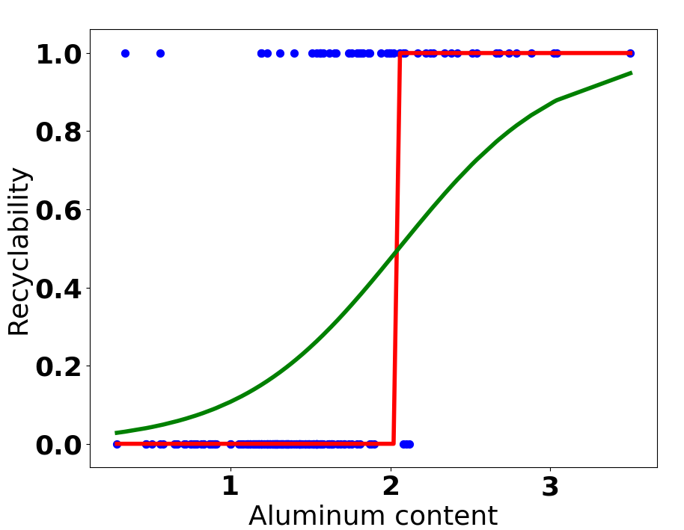
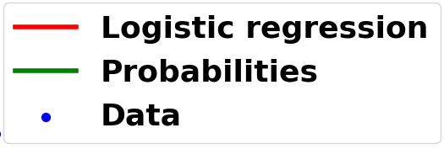
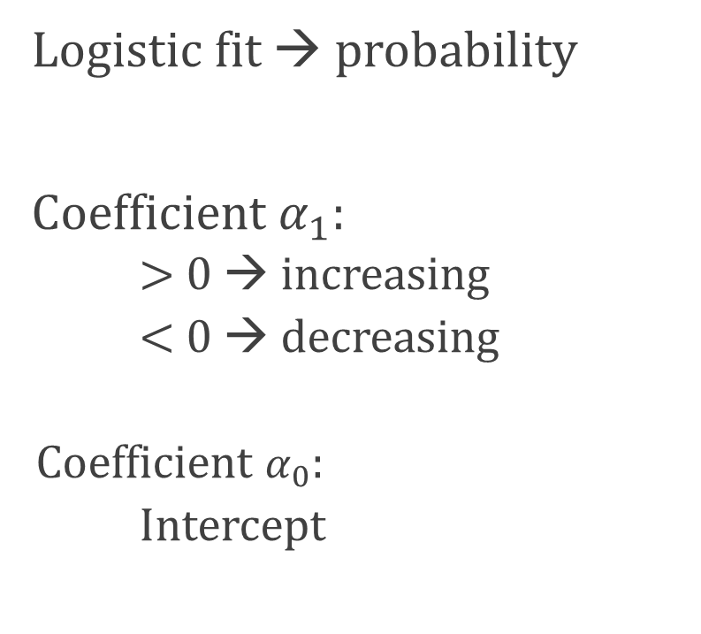
Apply logistic regression on the previous data set:
Logistic fit → probability
Coefficient $α_{1}$:
> 0 → increasing
< 0 → decreasing
Coefficient $α_{0}$:
Intercept

Slide 13

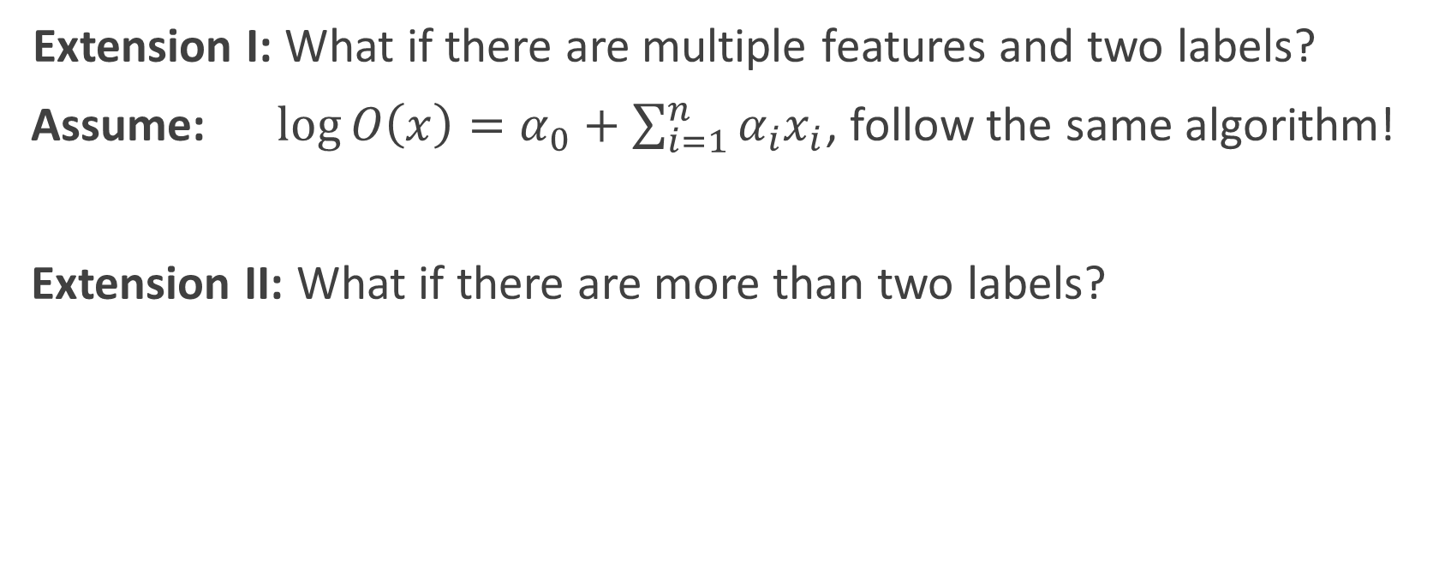
Extension I: What if there are multiple features and two labels?
Assume: $\log{O\left(x\right)=α_{0}+\sum_{i=1}^{n}{α_{i}x_{i}}}$, follow the same algorithm!
Extension II: What if there are more than two labels?

Slide 14
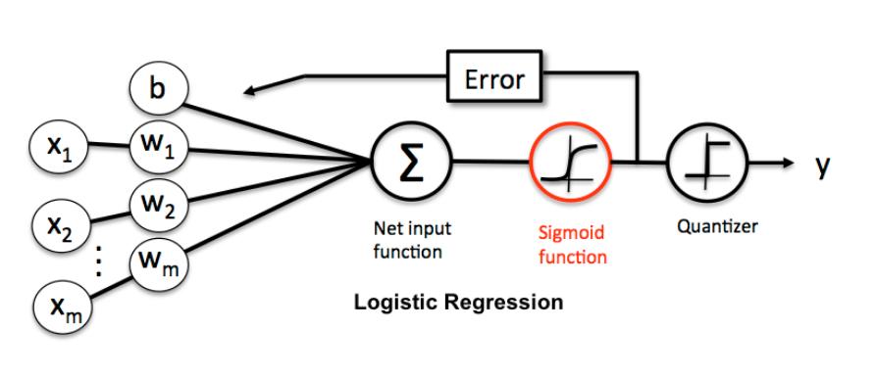
Softmax Regression

Slide 15
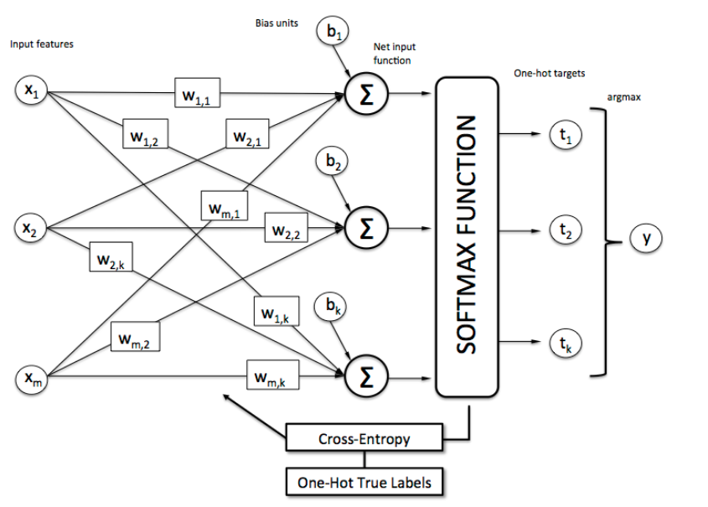

Slide 16
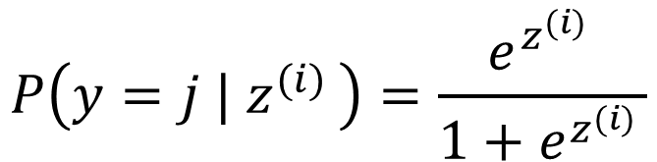
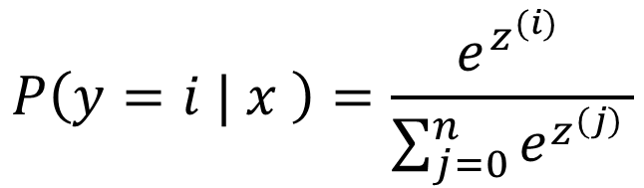
Previously we used logistic function:
$$P\left(y=j | z^{(i) }\right)=\frac{e^{z^{(i) }}}{1+e^{z^{(i) }}}$$
with the input $z^{(j)}=α_{(0,j)}+\sum_{i=1}^{n}{α_{(i,j)}x_{i} }$and
The “Softmax function” is a natural generalisation:
$$P\left(y=i | x \right)=\frac{e^{z^{(i) }}}{\sum_{j=0}^{n}{e^{z^{(j) }}}}$$

Slide 17
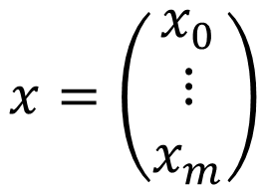
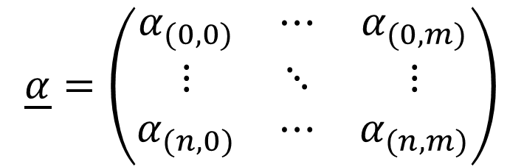
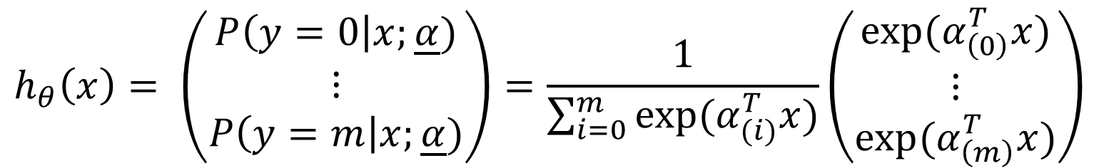

In terms of matrices:
$$\underline{α}=\left(\begin{matrix}α_{(0,0)} & ⋯ & α_{(0,m)} \\ ⋮ & ⋱ & ⋮ \\ α_{(n,0)} & ⋯ & α_{(n,m)}\end{matrix}\right)$$
$$x=\left(\begin{matrix}x_{0} \\ ⋮ \\ x_{m}\end{matrix}\right)$$
$z=$ $\underline{α}x$
The hypothesis is therefore that:
$$h_{θ}\left(x\right)= \left(\begin{matrix}P\left(y=0\right|x;\underline{α}) \\ ⋮ \\ P\left(y=m\right|x;\underline{α})\end{matrix}\right)=\frac{1}{\sum_{i=0}^{m}{exp⁡(α_{(i)}^{T}x)}}\left(\begin{matrix}exp⁡(α_{\left(0\right)}^{T}x) \\ ⋮ \\ exp⁡(α_{\left(m\right)}^{T}x)\end{matrix}\right)$$

Slide 18
Parameters $\underline{α}$ are determined by minimizing the cost function:

Slide 20
Regularisation

Slide 22
K-fold cross-validation
Predict how well the model generalizes to an independent set of data:
Dataset
Training set
Testing set
Rinse and repeat!

Slide 23
fold 1
TEST
Error 1
fold 2
TEST
Error 2
Average error
fold 3
TEST
Error 3
fold 4
TEST
Error 4

